Slide 1
CSE 170 Technical Teamwork Fall 2024
Quinn Briggs

Slide 2
Opening Prayer

Slide 3



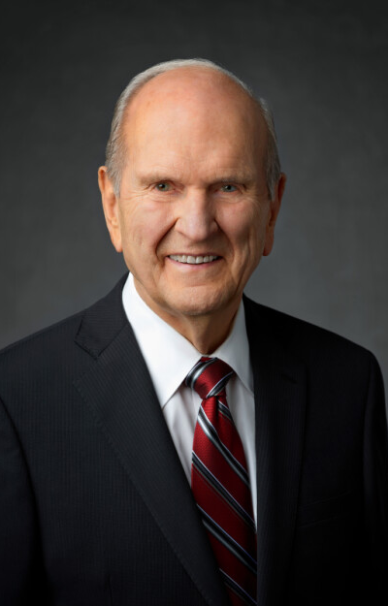


Be patient with yourself. Perfection comes not in this life, but in the next life. Don't demand things that are unreasonable, but demand of yourself improvement. As you let the Lord help you through that, He will make the difference.
Russel M. Nelson

Slide 4
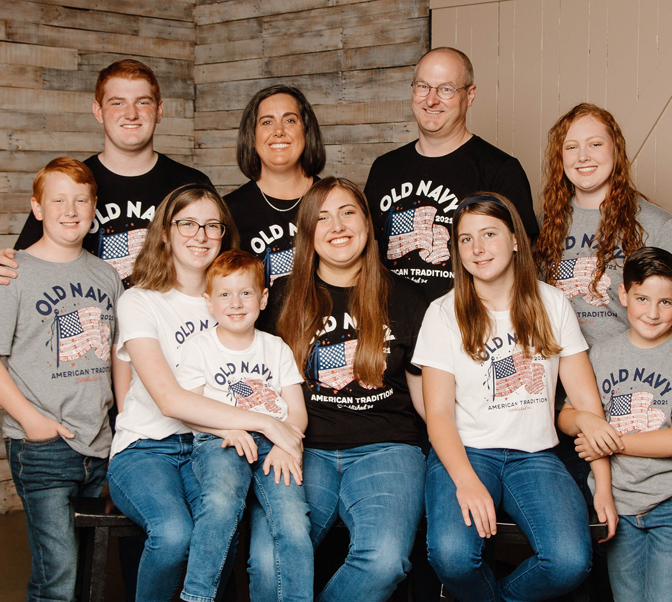
Your instructor – Quinn Briggs
Originally from Teton, Idaho just a few minutes away.
Lived in Idaho, Utah and Maryland
Served a mission in Munich, Germany
Married for 28 years
8 kids: ages 8 – 21 years old.
20+ year software industry veteran
Worked for startup, insurance, e-commerce and government
Worked as full-stack developer, team lead, manager and director
Love to compose and arrange music for the piano and other instruments.
Love to watch plays, movies, classical music concerts, also love to watch football and baseball.
I released an arcade style game for Android called “Treasure Hunt Race” over the summer. It still needs some work to be awesome.

Slide 5

Getting to know you
What is your name?
Where are you from?
One thing about you…

Slide 6

Icebreaker – Three of a Kind

Slide 7
Syllabus Stuff
Outcomes
1.0 Articulate the principles of teamwork.
2.0 Analyze work situations using the principles of teamwork.
3.0 Demonstrate the principles of teamwork.
Grading
30% Articulate (Prepare)
30% Analyze (Teach)
40% Demonstrate (Prove)

Slide 8
Class Expectations
Teamwork requires showing up
“Ninety percent of success in life is just showing up.” ― Woody Allen
Use your own thoughts for reflection questions
It is tempting to use AI to answer questions for you, but self-reflection is the key to growth in this class.
Points will be deducted for impersonal responses that sound like they came from AI
Complete assignments on time.
Your grade in this class hinges on timely completion of assignments.
Late assignments are penalized 2% per day, up to 30% deduction.
Accommodations are available if needed by discussing with me.
Attendance is required and roll will be taken starting next week.
Each unit has an attendance grade which comes from the roll.

Slide 9
Team Formation
Teams will form at the beginning of Week 3.
Teams will be formed based on the skills assessment found in Week 2.
Teams will be multi-functional and diverse, similar to teams found in a typical workforce.
We will use Microsoft Teams as a tool in this class to help us on certain assignments.

Slide 10


Slide 11
Table Discussion
In your table group discuss the following:
What is your strongest “hard skill”?
What is your strongest “soft skill”?
Is it a good idea to list “soft skills” on a resume? Why or why not?

Slide 12
Class Framework: Emotional Intelligence
Self-Awareness
Self-Management
Social Awareness
Relationship Management

Slide 13
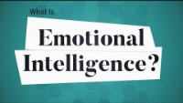

Slide 14
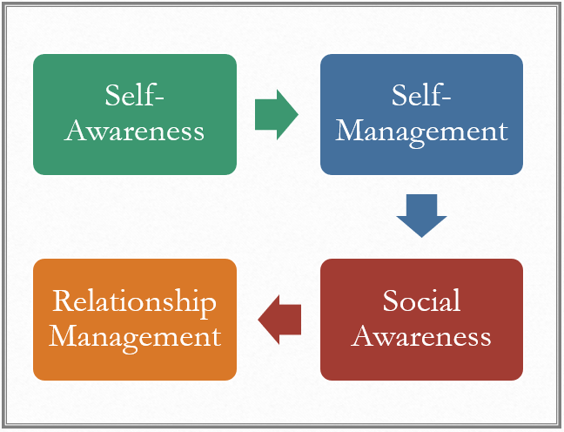
Table Discussion
Why do emotionally intelligent people make better teammates?

Slide 15
Next Time
U01 Prepare:
A Steady Upward Course
Teamwork: The Most Vital 'Soft Skill'?
Are you an ideal team player? | Patrick Lencioni | TEDxUniversityofNevada
U01 Prove: Self Assessment

